Slide 1

Real-time Object Detection for Autonomous Driving using Deep Learning
Duy Anh Tran, Pascal Fischer, Alen Smajic, Yujin So

Slide 2



Problem Framing
01
Related Work
02
System description
03
Experimental Results
04
Conclusion
05
Real-time Object Detection for Autonomous Driving
State-of-the-art Object Detection Models and Datasets
Implementation of state-of-the-art models: YOLO and Faster R-CNN
Comparison of Results from YOLO and Faster R-CNN
Conclusion and Future Work

Slide 3
01
Problem Framing

Slide 4

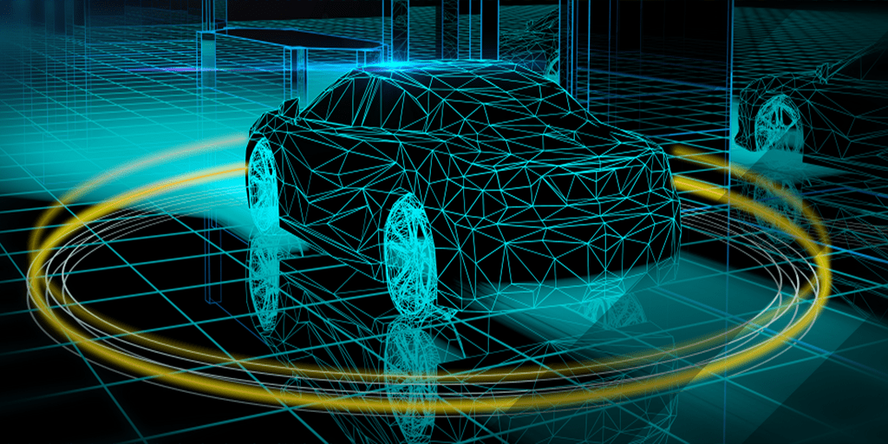
MOTIVATION: AUTONOMOUS DRIVING
One of the most anticipated technologies and active research topic
Major Challenges for Computer Vision and Machine Learning
Requirement of Autonomous Driving: Object Detection
Accurate and real-time Object Detection algorithms needed

Slide 5

The BDD100K Dataset
100,000 HD video sequences of over 1,100-hour driving experience
2D Bounding Boxes annotated on 100,000 images
13 different object classes
geographic, environmental, and weather diversity
State-of-the-art: hybrid incremental net (MAP: 45.7, threshold: 0.5)

Slide 6
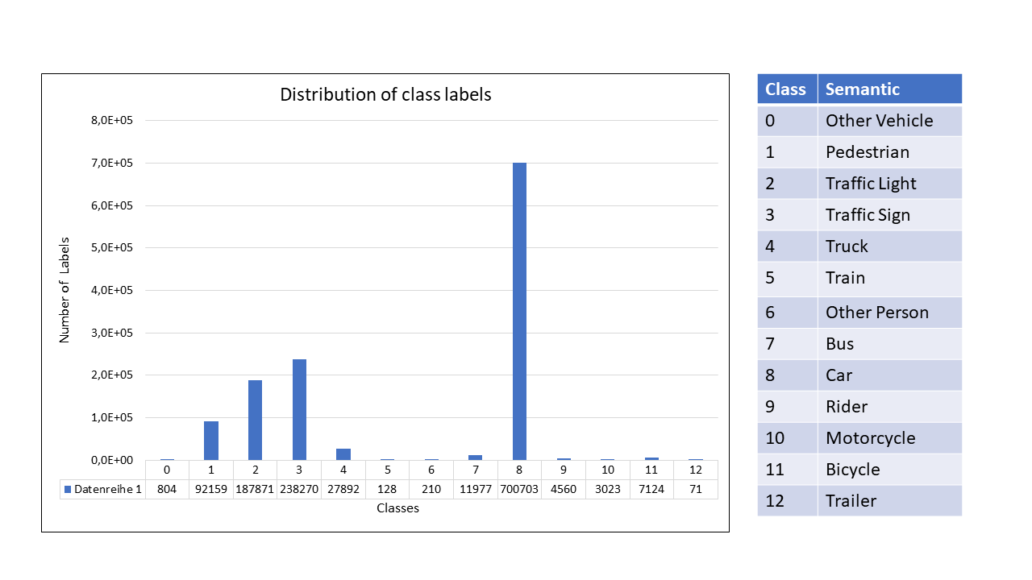
The BDD100K Dataset
Day Time Images: 57% Night Time Images: 43%
→ class imbalance

Slide 7
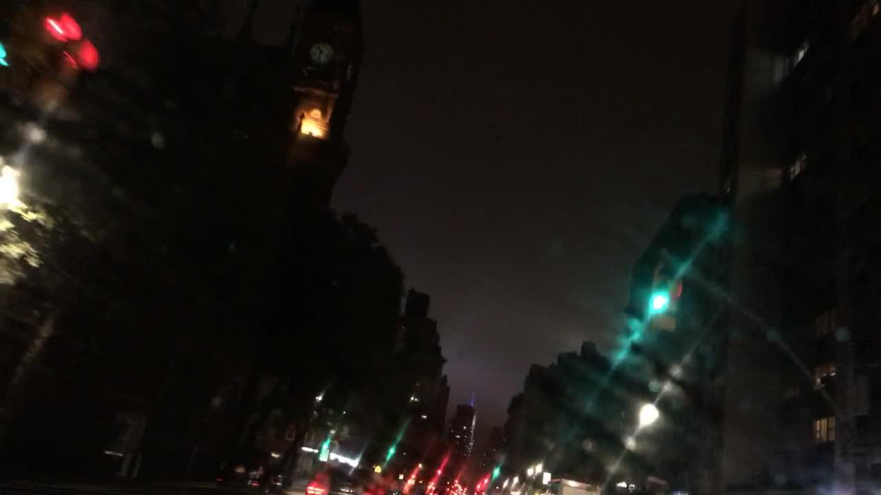
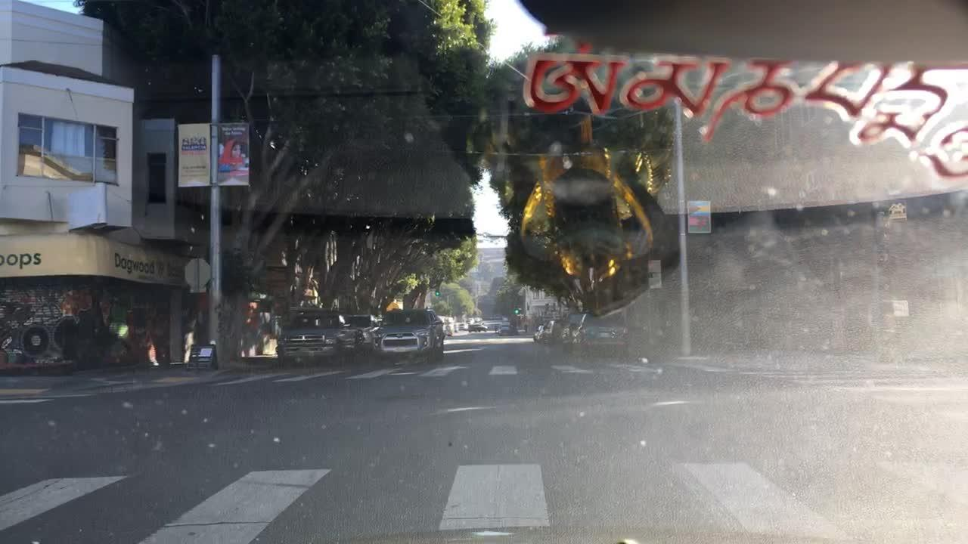
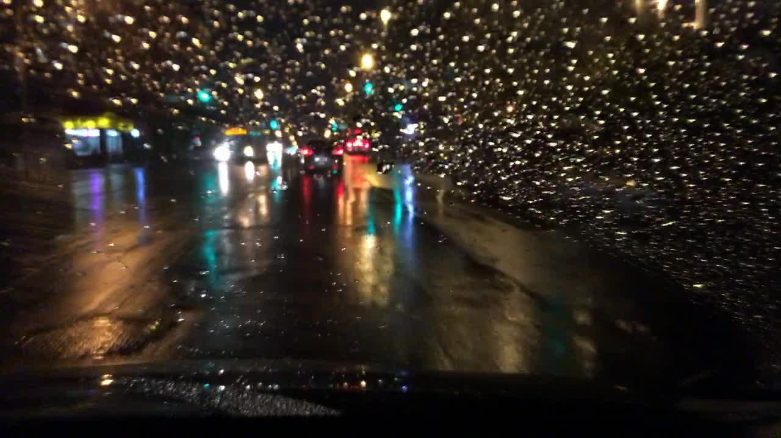
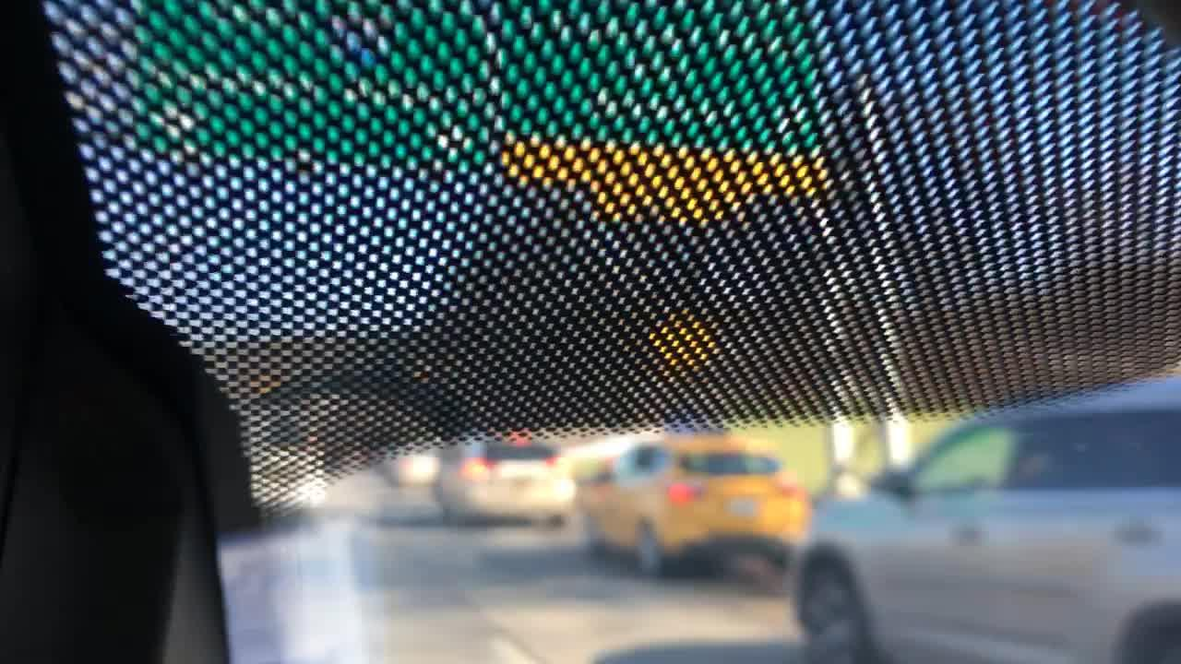
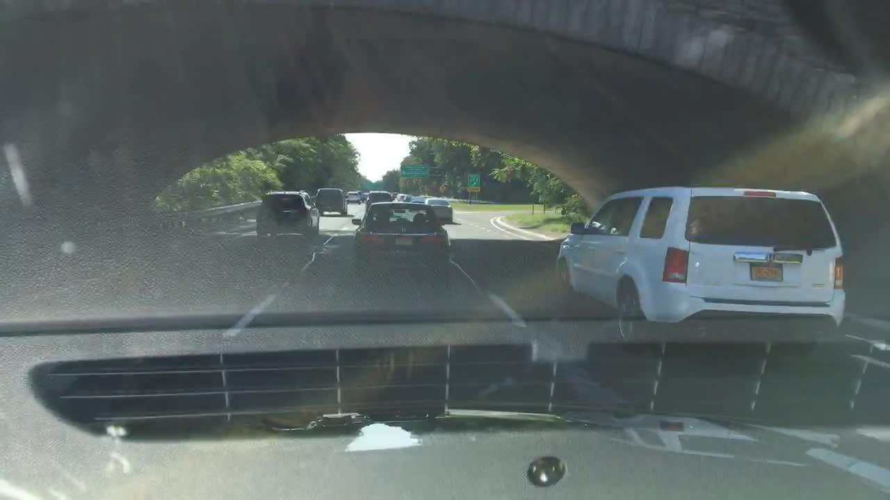
The BDD100K Dataset
Some hard samples from the dataset..

Slide 8
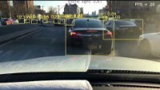
Approach
Real-time object detection of traffic objects in a video
Train YOLO and Faster R-CNN on BDD100K Dataset
compare performances: FPS and mAP

Slide 9
02
Related Work

Slide 10
Object Detection Models
Two-stage detectors
One-stage detectors
Stage: Region Proposals Stage: classification and bounding box regression | Stage: detection as regression problem
higher accuracy | lower accuracy
lower speed | higher speed
R-CNN Fast R-CNN Faster R-CNN Mask R-CNN | YOLO (v2, v3, v4) SSD

Slide 11
Driving Datasets
KITTI: Traffic scenes of Karlsruhe, 8 object classes
Waymo Open: 1950 driving videos, 4 object classes
nuScenes: 1,4 million images from Singapore and Boston, 1000 videos and 23 object classes
BDD100K: 100K Images and driving videos from cities in the US, 13 object classes

Slide 12
03
System description

Slide 13
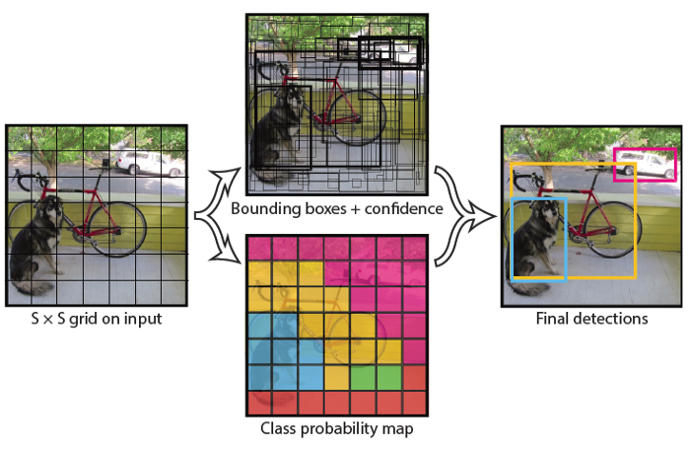
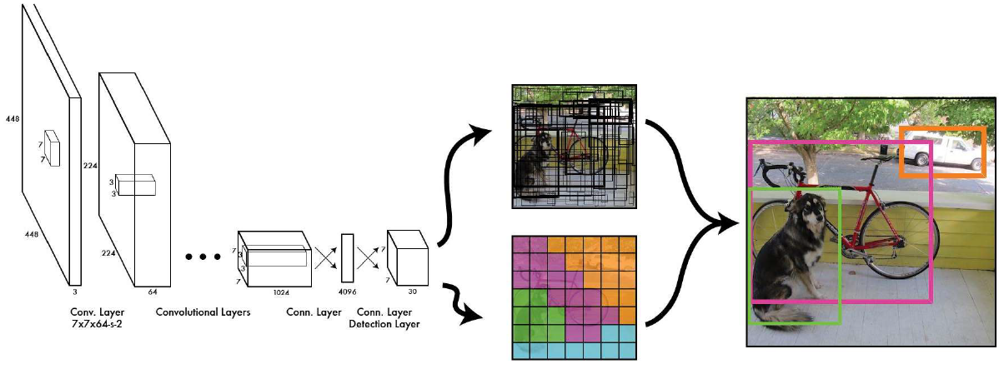
YOLO (You Only Look Once)
Single end-to-end CNN
Object Detection as single regression problem
Divides image into S x S grid cells and predicts for each cell:
B(=2) bounding boxes with 4 coordinates and confidence score
C class probabilities
Map object to grid cell containing center of object

Slide 14
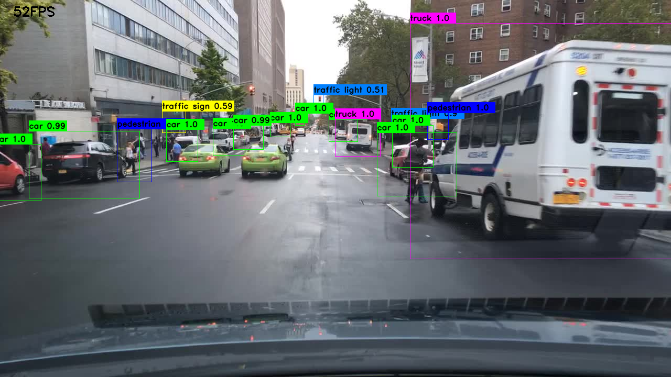
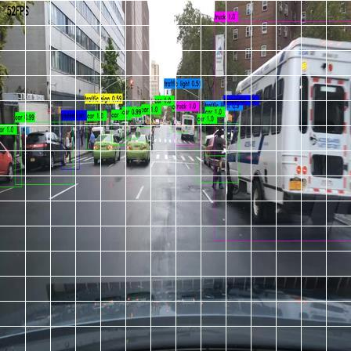
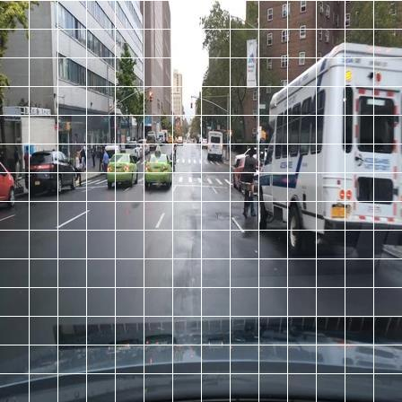

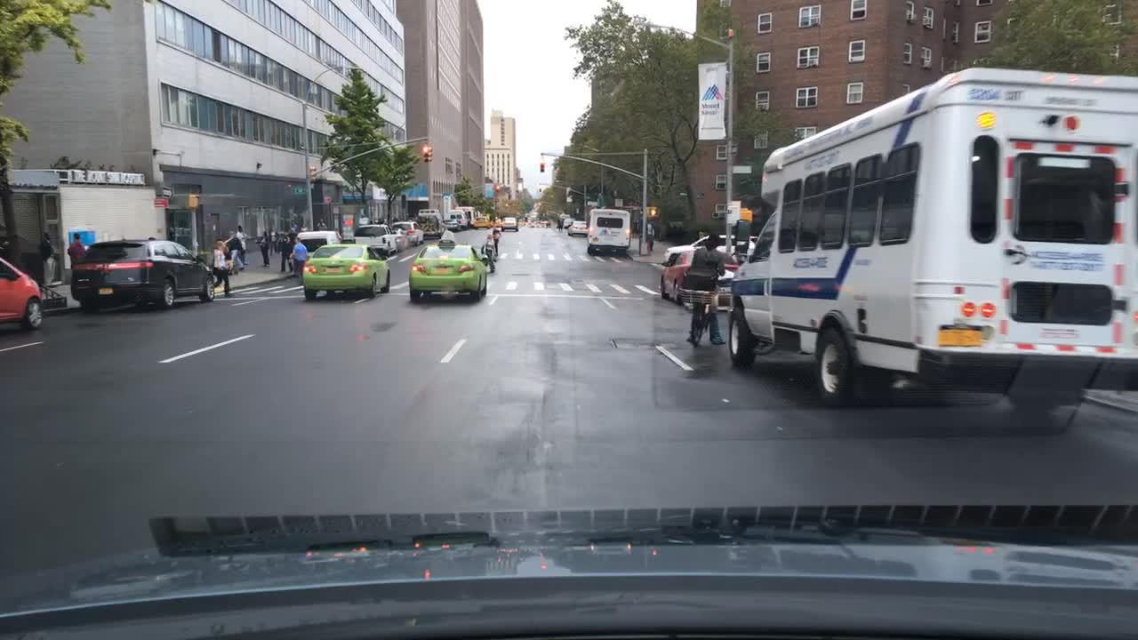
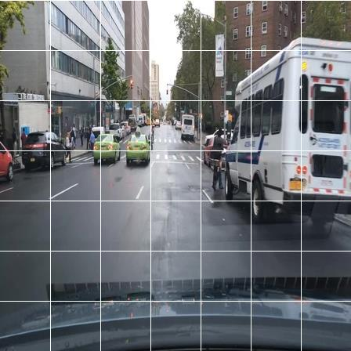
YOLO (You Only Look Once)
S = 7 (paper)
S = 14
Implementation from scratch
Numerous objects inside images
→ Increase grid cell size to S=14
→ Increase output parameters from 1127 to 4508
→ 23th convolutional layer: stride 1 instead of 2 to retain size 14 x 14

Slide 15
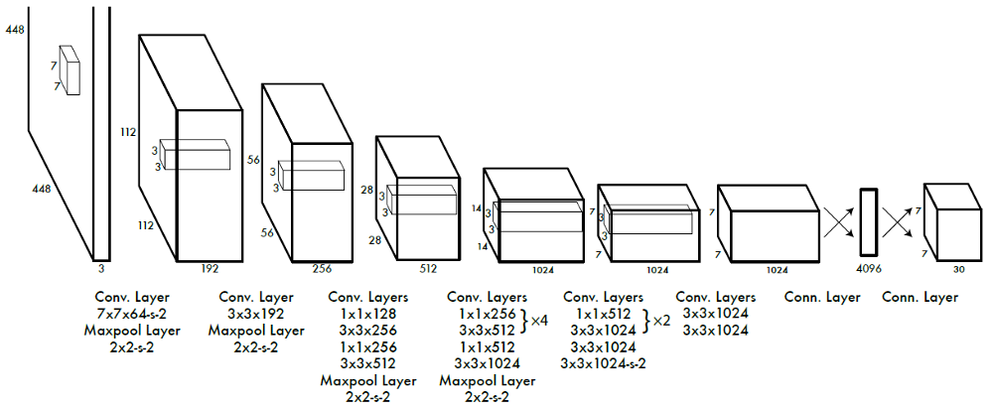
YOLO (You Only Look Once)
24 convolutional layers
4 pooling layers
2 fully connected layers
1 x 1 convolutions to reduce number of feature maps
Leaky ReLU activation after layers
Dropout between two fully connected layers
→ Added batch normalization between layers
→ 23th convolutional layer:
Change stride size to 1 to retain size 14 x 14

Slide 16
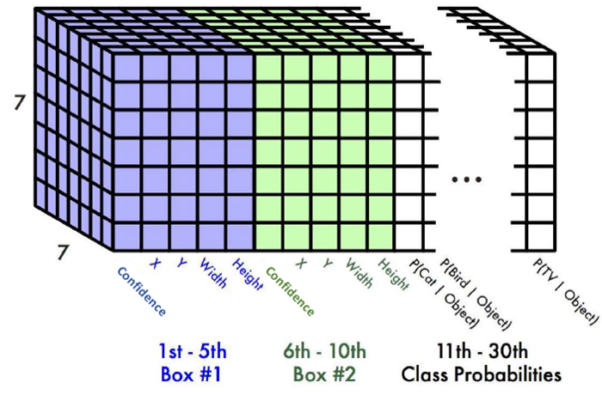
YOLO (You Only Look Once)
Output tensor of YOLO:
S x S x (B x 5 + C)
paper:
7 x 7 x (2 x 5 + 20)
→ Each grid cell represented by a vector of length 30
Our model:
14 x 14 x (2 x 5 + 13)

Slide 17
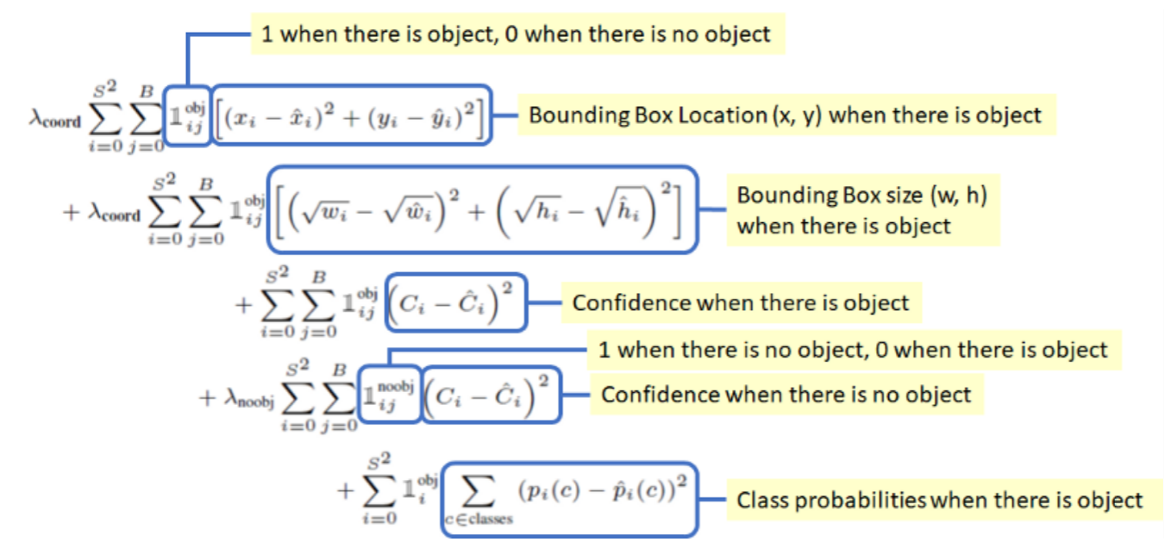
YOLO (You Only Look Once)
Loss function

Slide 18
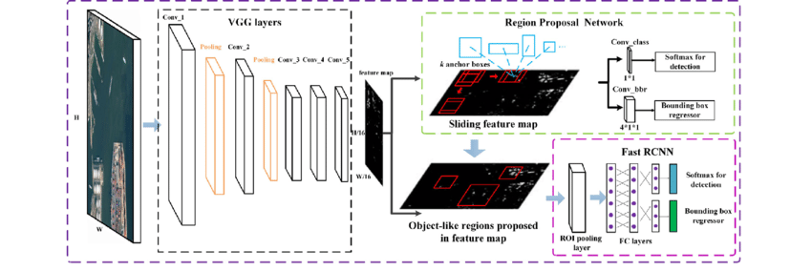
Faster R-CNN
Consists of three parts:
Backbone: classification network (i.e. VGG, ResNet)
→ pretrained on ImageNet
→ generate high resolution feature maps (input: 640x640)

Slide 19
Faster R-CNN
Consists of three parts:
Backbone: classification network (i.e. VGG, ResNet)
→ pretrained on ImageNet
→ generate high resolution feature maps (input: 640x640)
RPN (Region Proposal Network)

Slide 20
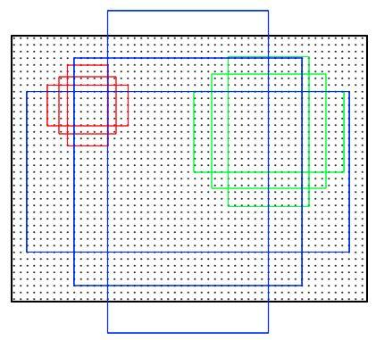
Region Proposal Network (RPN)
one convolutional layer to predict (~ 2000) region proposals
Predict classification score (object in anchor box or not)
Bounding boxes (better localization of objects)
9 predefined anchor boxes:
sizes {128, 256, 512}
aspect ratios {0.5, 1, 2}
Anchors slide over window with stride 16

Slide 21
Faster R-CNN
Consists of three parts:
Backbone: classification network (i.e. VGG, ResNet)
→ pretrained on ImageNet
→ generate high resolution feature maps (input: 640x640)
RPN (Region Proposal Network)
Fast R-CNN

Slide 22
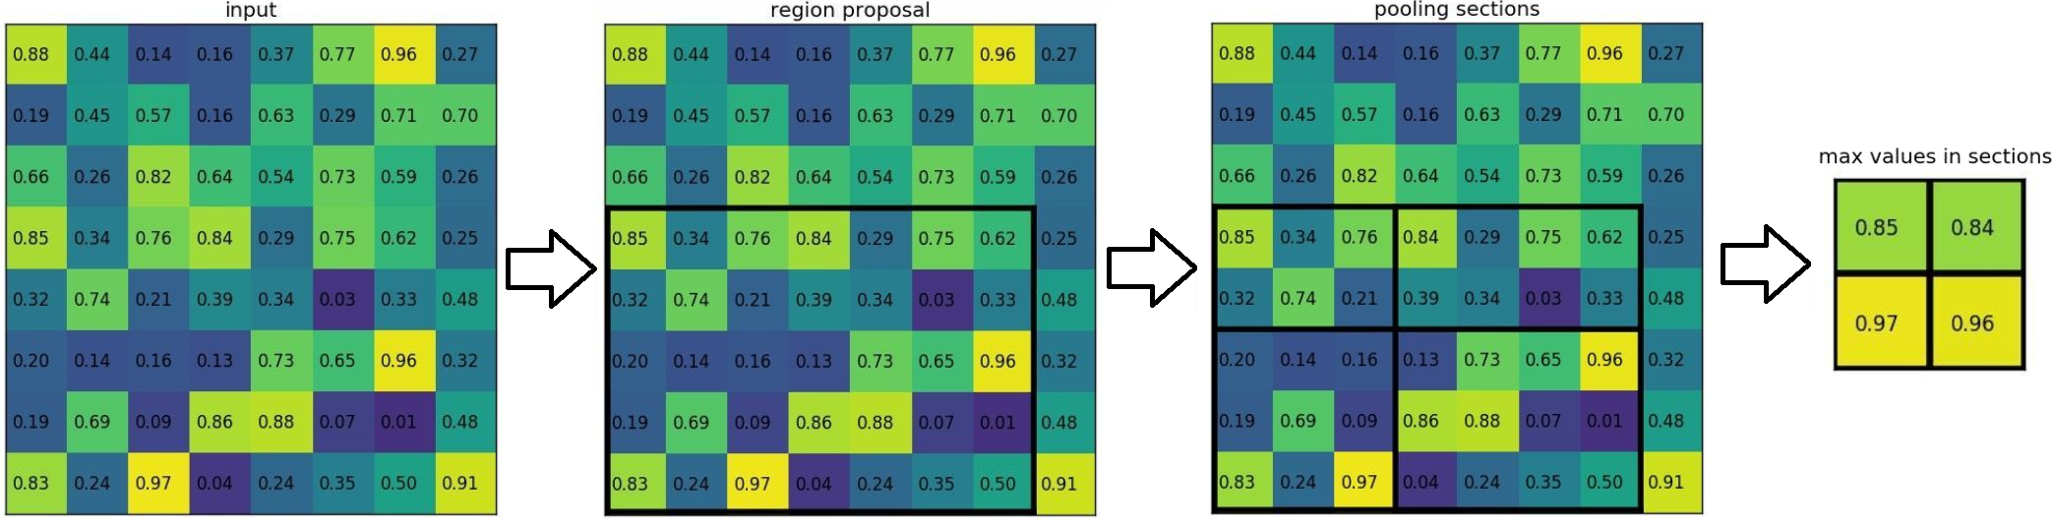
Fast R-CNN
Receives high resolution feature maps and region proposals
ROI pooling layer: get fixed sized region proposals
Outputs:
Softmax Score for every class
Corrected bounding boxes for the region proposals
Loss:
Regression: log loss
Bounding box: smooth L1 loss
ROI pooling

Slide 23
04
Experimental Results

Slide 24
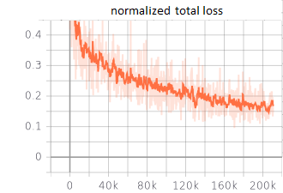
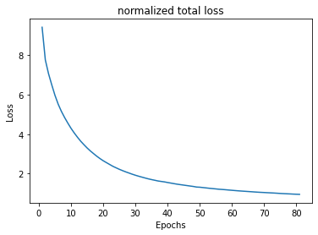
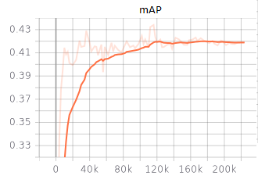
Evaluation
YOLO
Faster R-CNN
Epochs: 81
Learning rate: 1e-5 (decreasing)
Batch size: 10
Epochs: 60
Learning rate: 1e-4 (decreasing)
Batch size: 16
 | mAP | FPS
YOLO | 18,6 | 212,4
Faster R-CNN | 41,8 | 17,1
Hybrid incremental net | 45,7 | unknown
Measured on a NVIDIA V100 SXM2 32GB

Slide 25
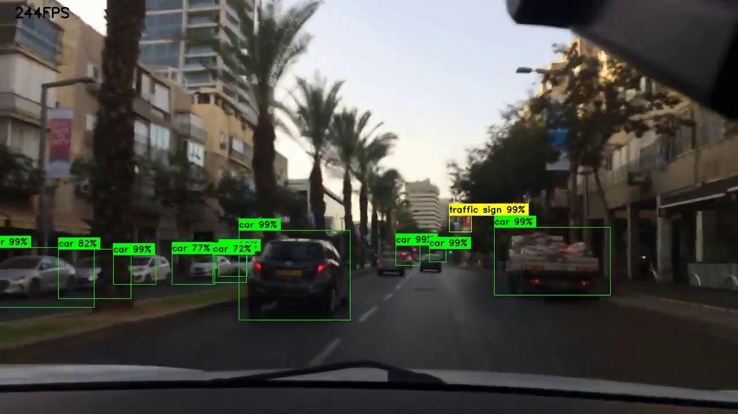
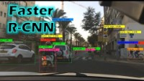
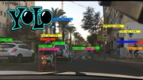
YOLO
Faster R-CNN

Slide 26
05
Conclusion and Future Work

Slide 27
Conclusion and Future Work
Conclusion:
Faster R-CNN: high accuracy, but lower FPS
YOLO: high FPS, but lower accuracy
Future Work:
We used the first version of YOLO → use of newer YOLO versions
Further experiments with other models
Achieve high accuracy AND high FPS

Slide 28
Workload
Implement YOLO
Implement Faster R-CNN
Report and Presentation
Pascal
Alen
Duy
Yujin

Slide 29
THANKS!
Do you have any questions?
Duy
Pascal
Alen
Yujin

